Slide 1

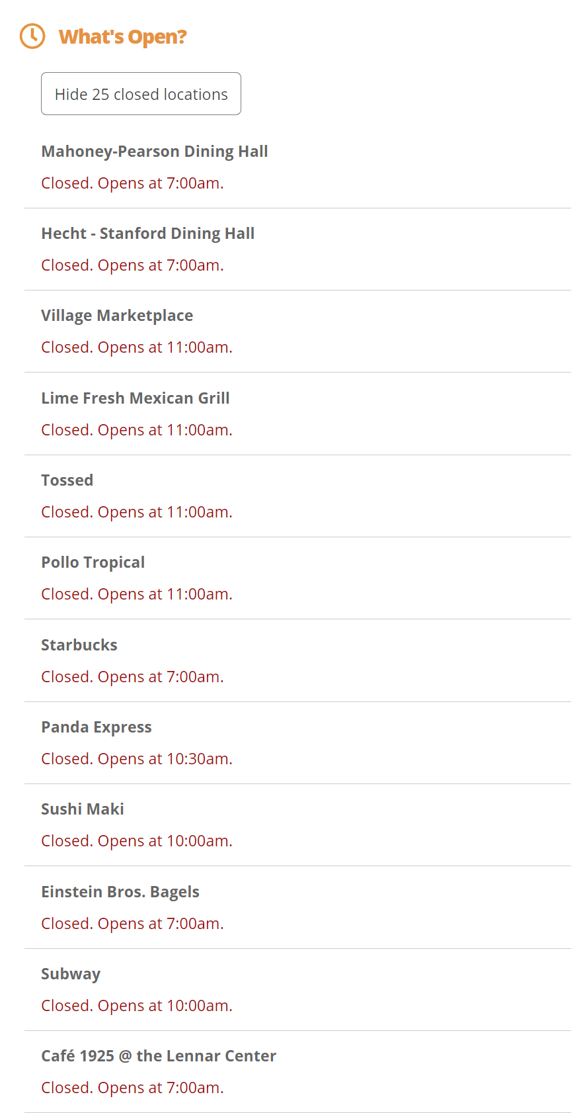
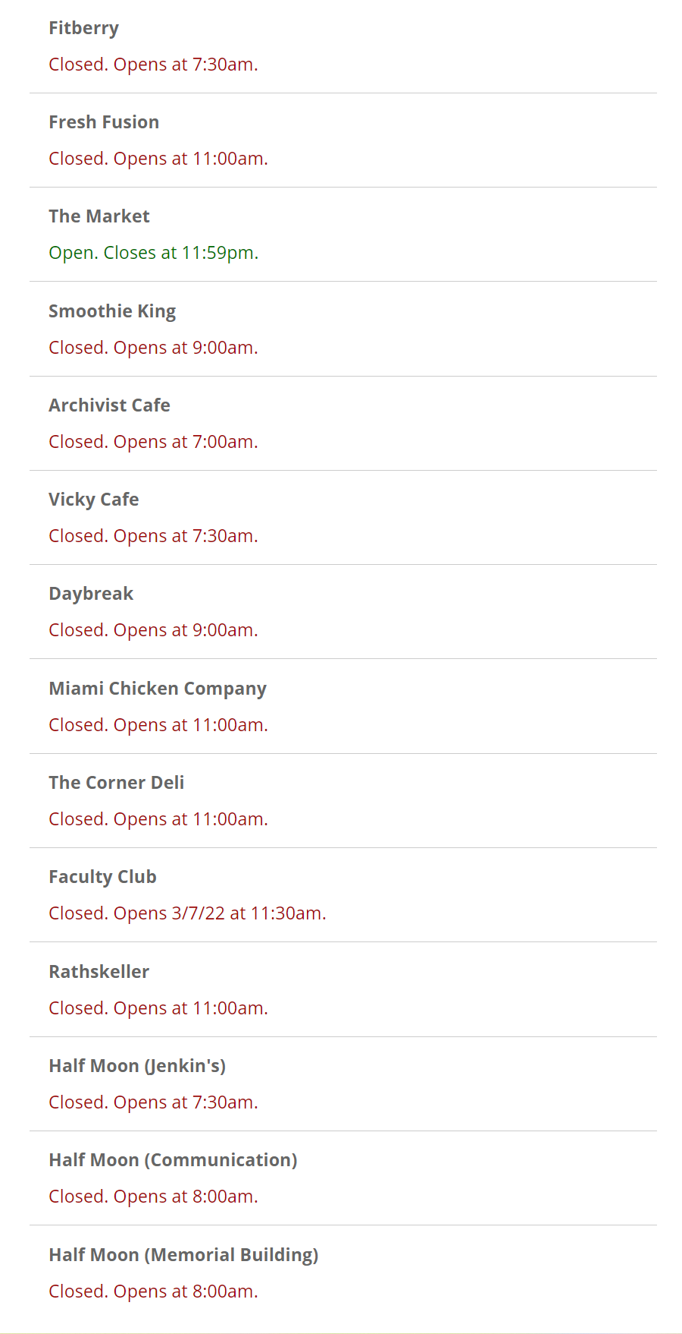
UHungry?
David Mills
Matthew Maya
Nicholas Sosnivka

Slide 2

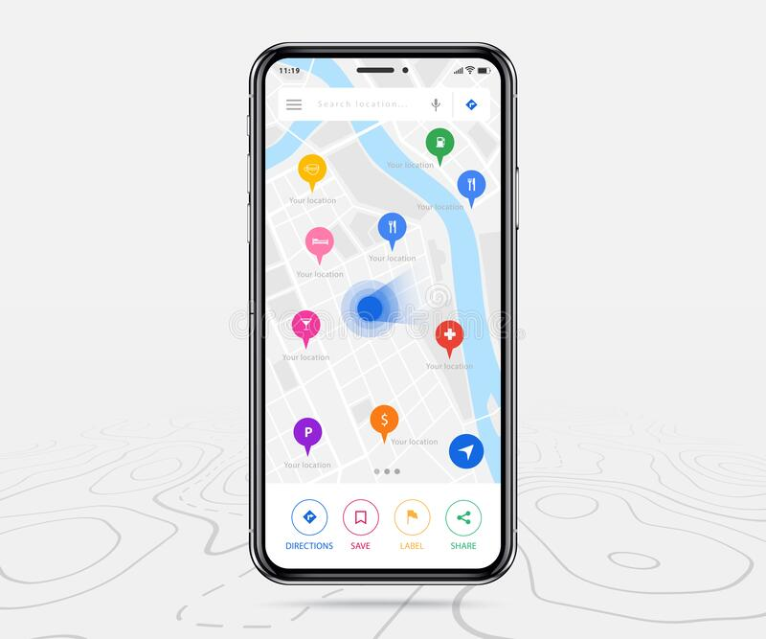
Concept
Mobile application (IOS and Android)
Similar to Waze (Wait Times & Traffic for food locations)
Powered entirely by users
Universities/On campus
Need a big enough user base
Users must register in order to use UHungry?
Users self report time depending on (# of people and average order time. Lots of Data to be collected)
Access to all food locations on campus (including frequent food trucks)

Slide 3
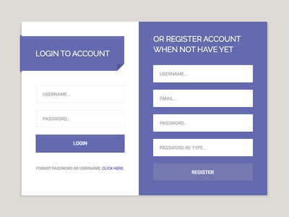
Design
User will register
Select University/Campus
Reverted to main map page
Dining location cards for pinned locations
3 Bottom Icons (map, list, settings)
Filter/Search bar

Slide 4
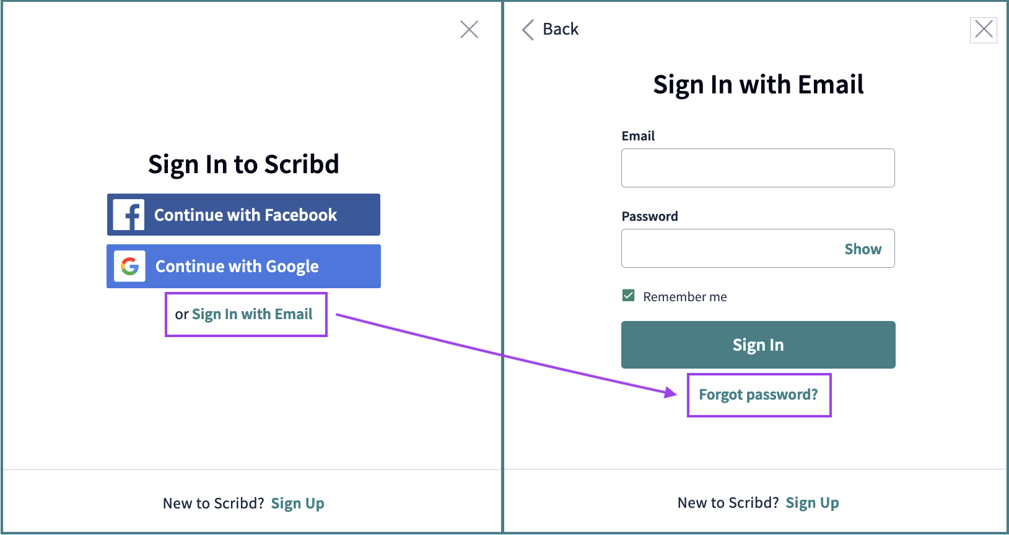
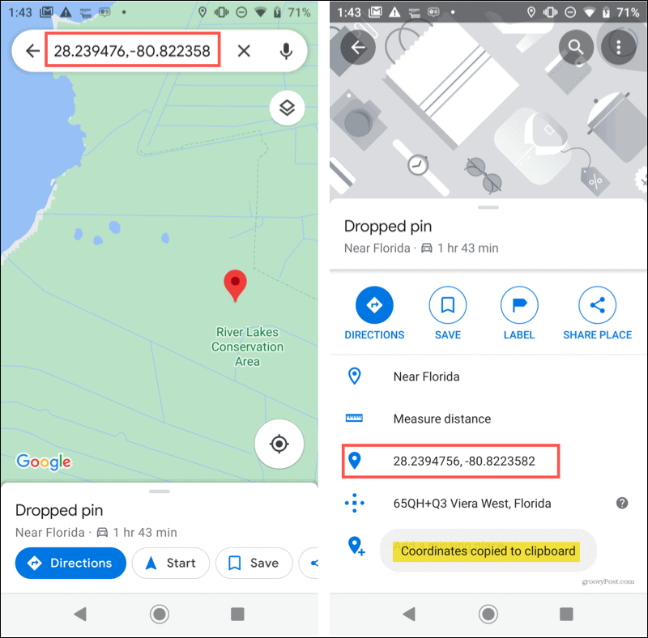
Functional Requirements
Account Sign Up
Account Sign In
University Select Screen
University Map Screen
Food Location Screen
Food Locations Filter Tab
Dining Location Cards
Post Waiting Time
Search
Profile Details
Update Profile
Password Recovery

Slide 5

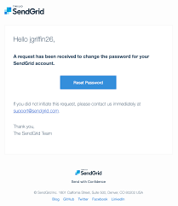

Non-Functional Requirements
Application Uptime
99.9% uptime (no more than 45 minutes down each month)
Exceptions for necessary maintenance changes
Search Result Times
Dining search should return in under 800ms
Wait time Algorithm
Should draw from recent user input and update in intervals depending on traffic
Automatic Password Reset
Must have back-end / server functionality to automatically send emails for password reset.
Data fetch and rendering time
Any screen that needs to render data fetched from the database should do so in under 500ms
User data encryption
All user data should be secured by both at rest and in transit encryption

Slide 6
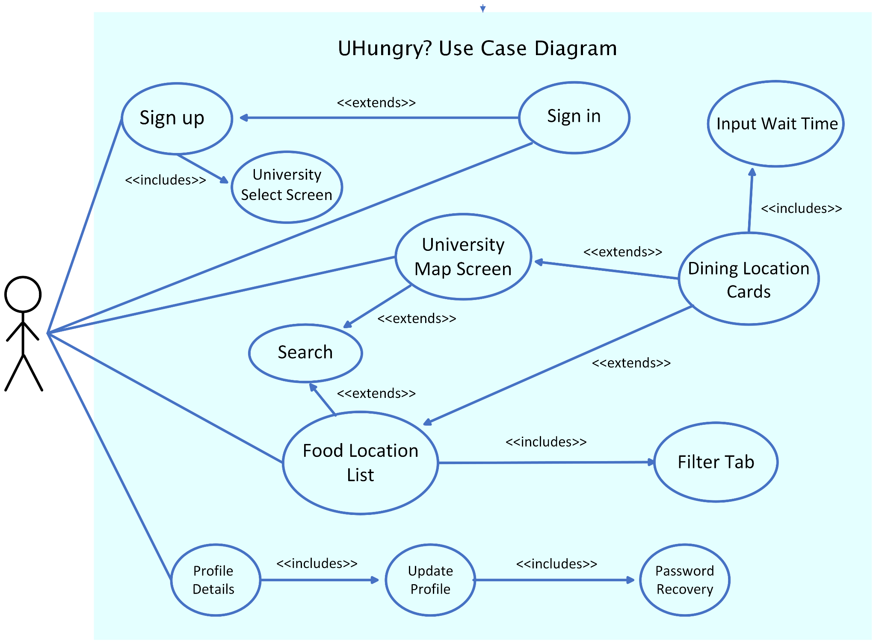
Use Case Diagram

Slide 7






System Constraints
Tool Constraints
Flutter
AWS amplify
Amazon RDS MySQL
Apple/Google Maps
Language Constraints
Dart, GraphQL
Platform Constraints
IOS/Android
Hardware Constraints
Mobile Device
Network Constraints
Network Connection
Deployment Constraints
Amazon Web Services
Transition & Support Constraints
Github Version Control
Budget & Schedule Constraints

Slide 8
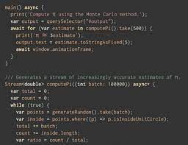

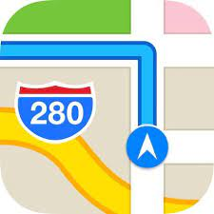

Tool & Language Constraints
Tool Constraints
Flutter
Front end of the application (UI)
Aws Amplify
Backend Package on AWS
Integration of many AWS services and toolkits
Amazon RDS MySQL
Relational Database
Apple/Google Maps
For maps page and food locations
Language Constraints
Dart
Flutter framework uses Dart programming language
Widgets Structure
GraphQL
Querying Language for fetching and storing data
Managed through Amplify

Slide 9


Platform & Hardware Constraints
Platform Constraints
IOS or Android
The app can only be downloaded on an IOS or Android device
Hardware Constraints
Mobile Device
The user must own a mobile device with internet access in order to use the app

Slide 10

Network & Deployment Constraints
Network Constraints
Network Connection
Users need a network connection in order to access functionality for the app
Deployment Constraints
Amazon Web Services
Deployed on AWS servers
Using Amazon RDS MySQL database

Slide 11
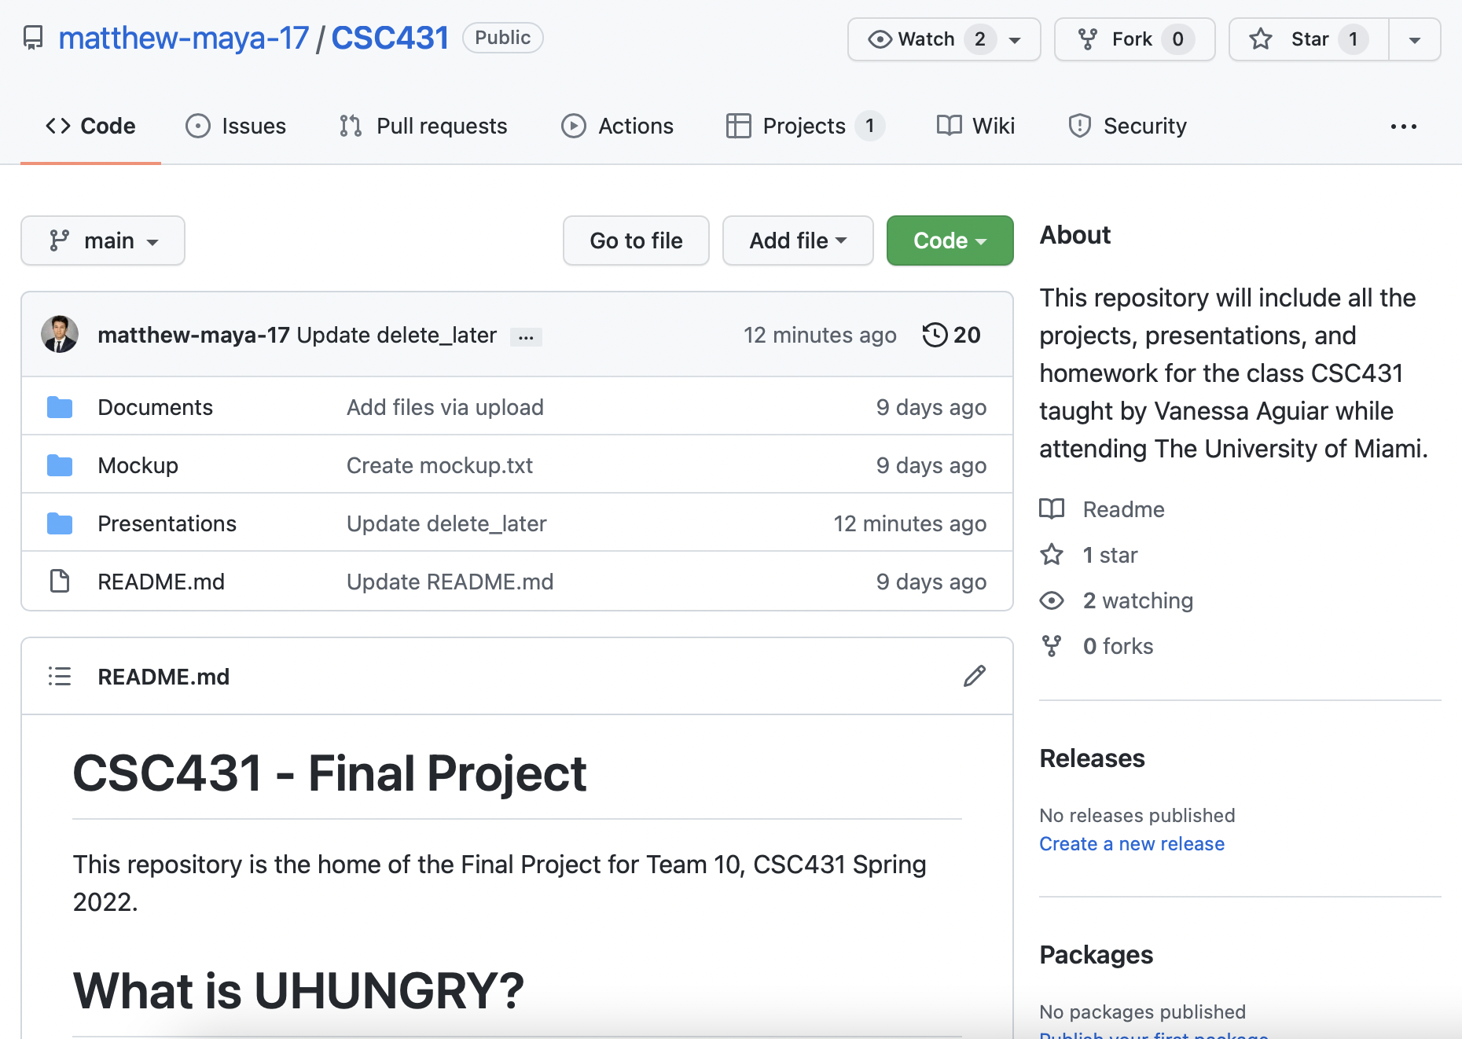
Transition and Support Constraints
Github
Repository for version control
Collaboration
Organization of documents and code

Slide 12


Budget & Schedule Constraints
Time Constraints
Have until the end of the semester (May 2022)
Mockup, SRS, SAS
Budget Constraints
No budget for the project
Will use free AWS packages

Slide 13
Thank you for listening
U HUNGRY?

